Slide 1

How Does a Bike-Share
Navigate Speedy Success?
Case Study:
Cyclistic BIKE-SHARE
Lucjan Konopka
November 2022

Slide 2
Background
user types
annual members
casual users
Cyclistic’s finance analysts have concluded that annual members are much more profitable than casual riders. Maximizing the number of annual members will be key to future growth.
single-day pass users
full-day pass users

Slide 3
Motivation
?
The goal of the analysis:
understand how casual riders and annual members use Cyclistic bikes differently in one year period
design a new marketing strategy to convert casual riders into annual members

Slide 4
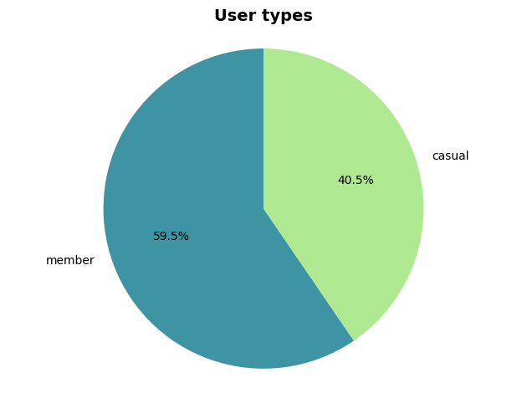
User types
Almost 60% of rides in the reviewed period were carried out by regular members. There is still huge potential to gain more members out of casual riders.

Slide 5
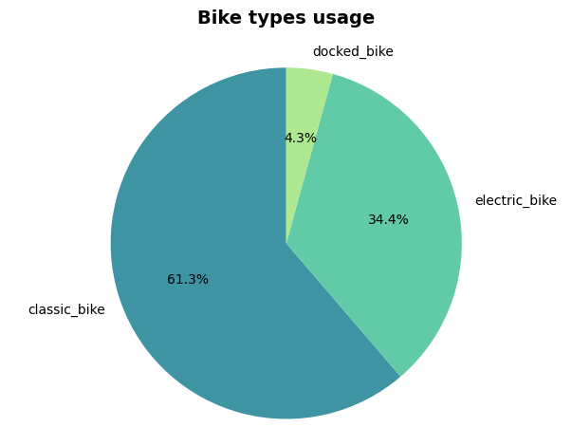
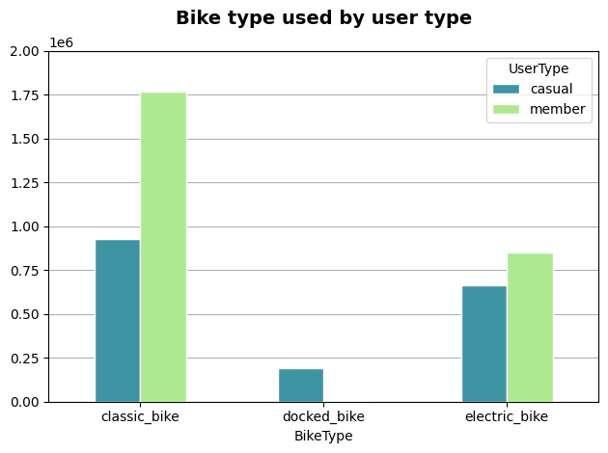
Bike types used
Most popular bike among both types of users was the classic bike. In fact, docked bikes were only used by casual riders.

Slide 6
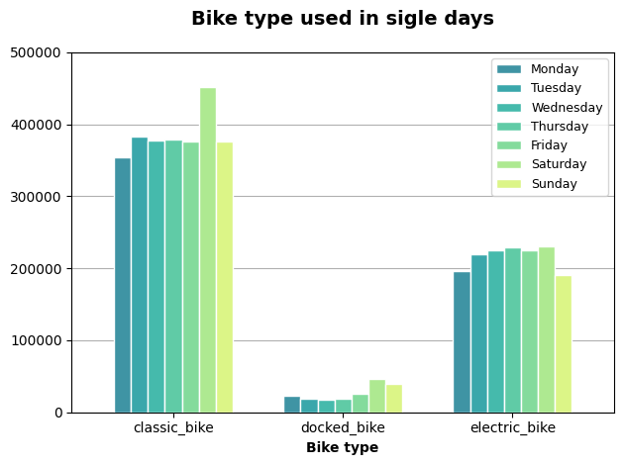
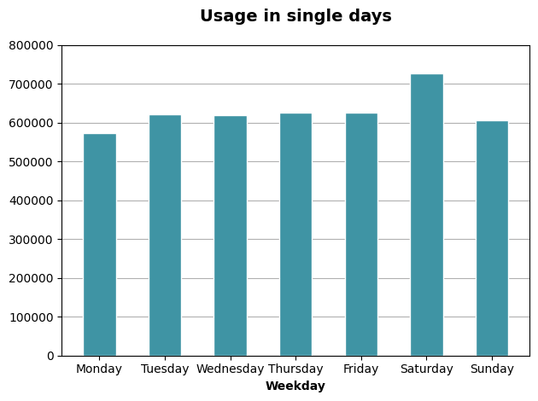
Usage in single days
Most of the rides took place on Saturday, especially when it came to the classic bikes. There is a pattern showing slightly less bikes usage at the beginning and end of the week.

Slide 7
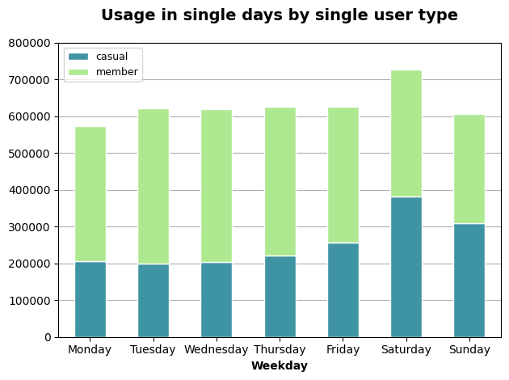
Usage in single days by single user type
The data shows a big difference in bicycle usage of casual users over a week, while annual members used bicycles more regularly.
Splitting the graph allows for a more accurate analysis…

Slide 8
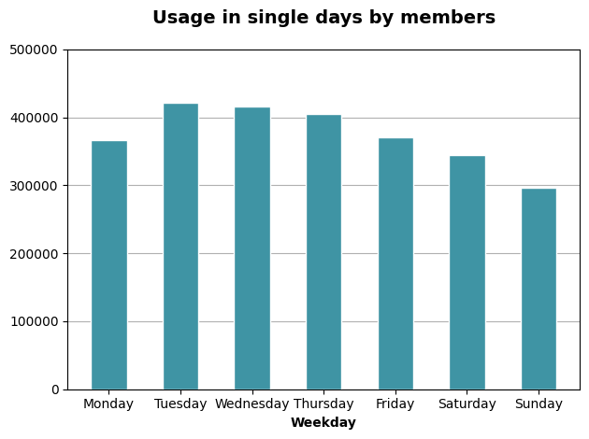
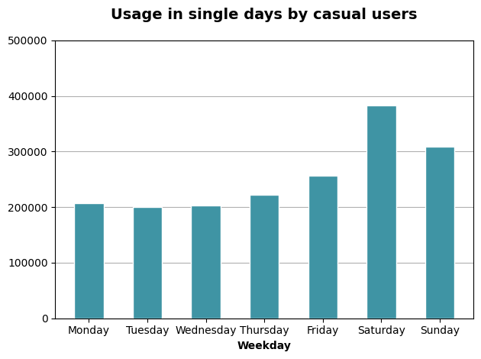
Usage in single days by single user type
Annual members used bikes more during the work week and less on weekends. The opposite relationship can be observed in case of casual users, while the closer to the end of the working week, them more bike rentals.

Slide 9
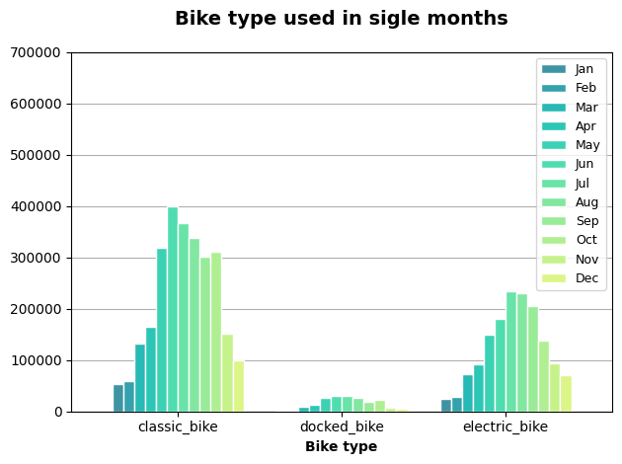
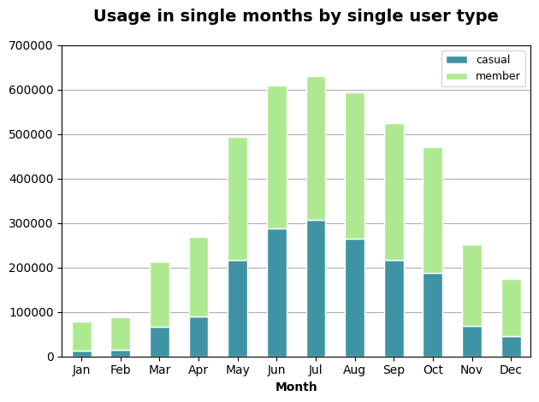
Usage in single months
The vast majority of rentals took place in the warm season from May to October.

Slide 10
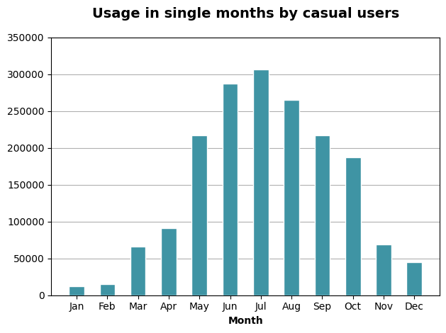
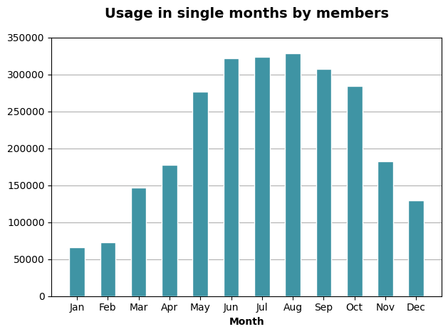
Usage in single months by single user type
All users used bicycles more often in the warm months. Peak for casual users was the period from June to August, statistically the hottest months of the year. High number of rides also took place in May, September and October.

Slide 11
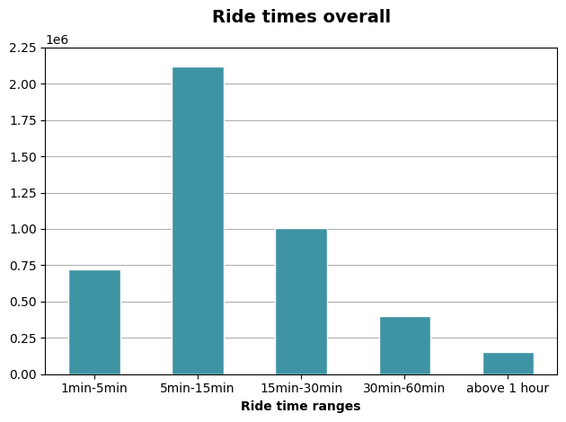
Ride times
Most rides were short trips between 5 to 15 minutes. Slightly longer trips, up to 30 minutes, were also a significant part of the whole database.

Slide 12
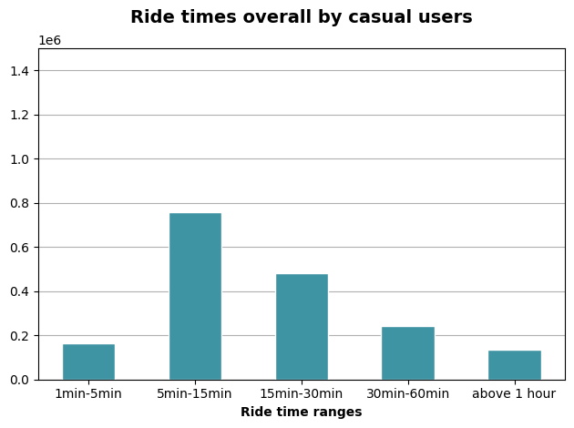
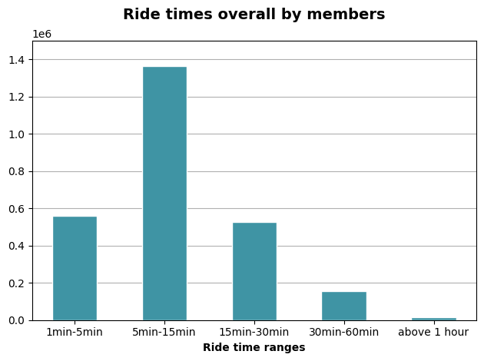
Ride times by single user type
There is a visible pattern showing that users are more likely to take longer trips in comparison to annual members.

Slide 13
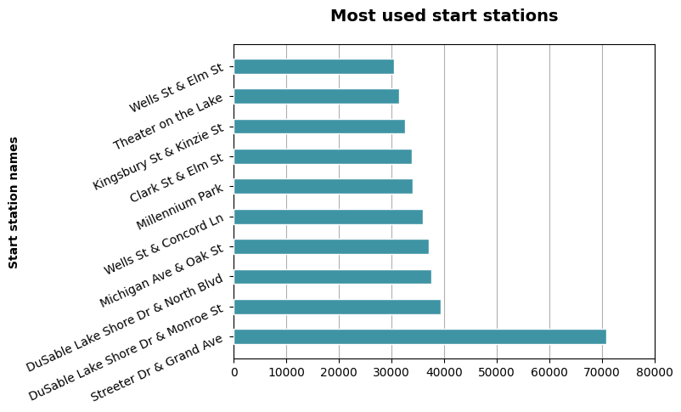
Most popular start stations
The station that stands out from the rest and is the most popular is the station Streeter Dr & Grand Ave.

Slide 14
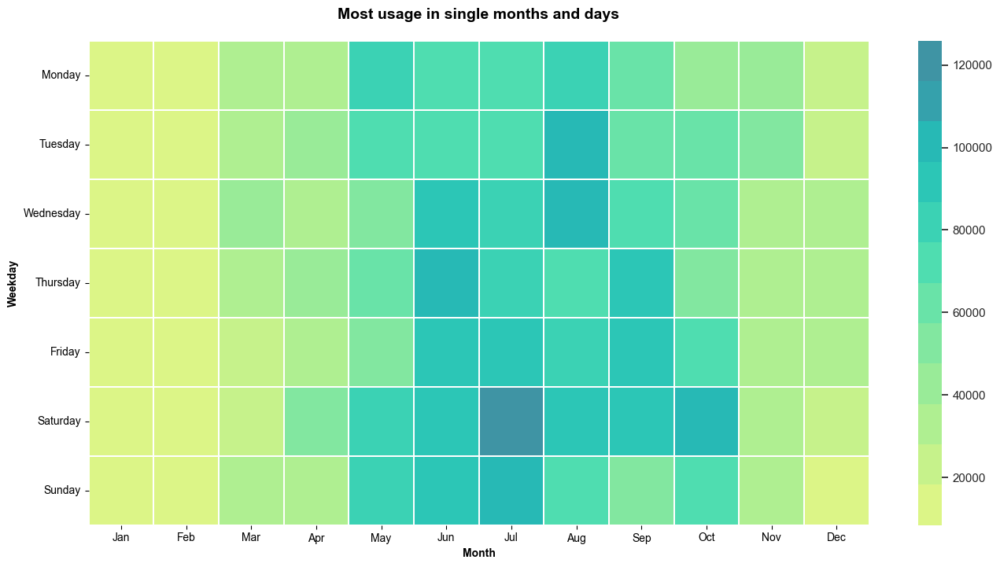
Most usage in single months and days
The most popular days of the year were Saturdays in August. Midweek in the warm months were very popular as well. Winter months were the least popular.

Slide 15
Marketing strategies
Free months for inviting friends
Giving one free month of membership for each annual member who has invited a friend which has purchased an annual membership
05
Most digital ads on Saturdays in summer
Accumulating of the most flashy ads on the most popular day of the week in the warmest months, starting in May/June
01
04
Discounts for long term members
Giving one free month for each year of membership as an annual member of Cyclitics
Billboard ad in Streeter Dr & Grand Ave
Placing a billboard promoting the health benefits of cycling and the benefits of annual membership at the most frequented bicycle station
02
03
Notifications for casual users
Sending notifications to remind regular casual riders of the long term pricing benefit

Slide 16
Thank you for your attention!

